Slide 1


Group 10: Michael Cubriel, Gabe Dare, Joaquin Salas, Sandip Singh
Predicting Airbnb Availability

Slide 2
Problem Statement
Background: Airbnb's influence varies across cities, this impacts local housing markets and tourism sectors.
Objective: Predict and analyze the availability trends of Airbnb properties in six cities to help investors interested in Airbnbing their property.
Main Research Question: How accurately can we predict and explain the availability of Airbnb properties across different cities?
Importance: Insights from this study could serve as a guide for investors, enhancing economic opportunities and residential satisfaction.

Slide 3
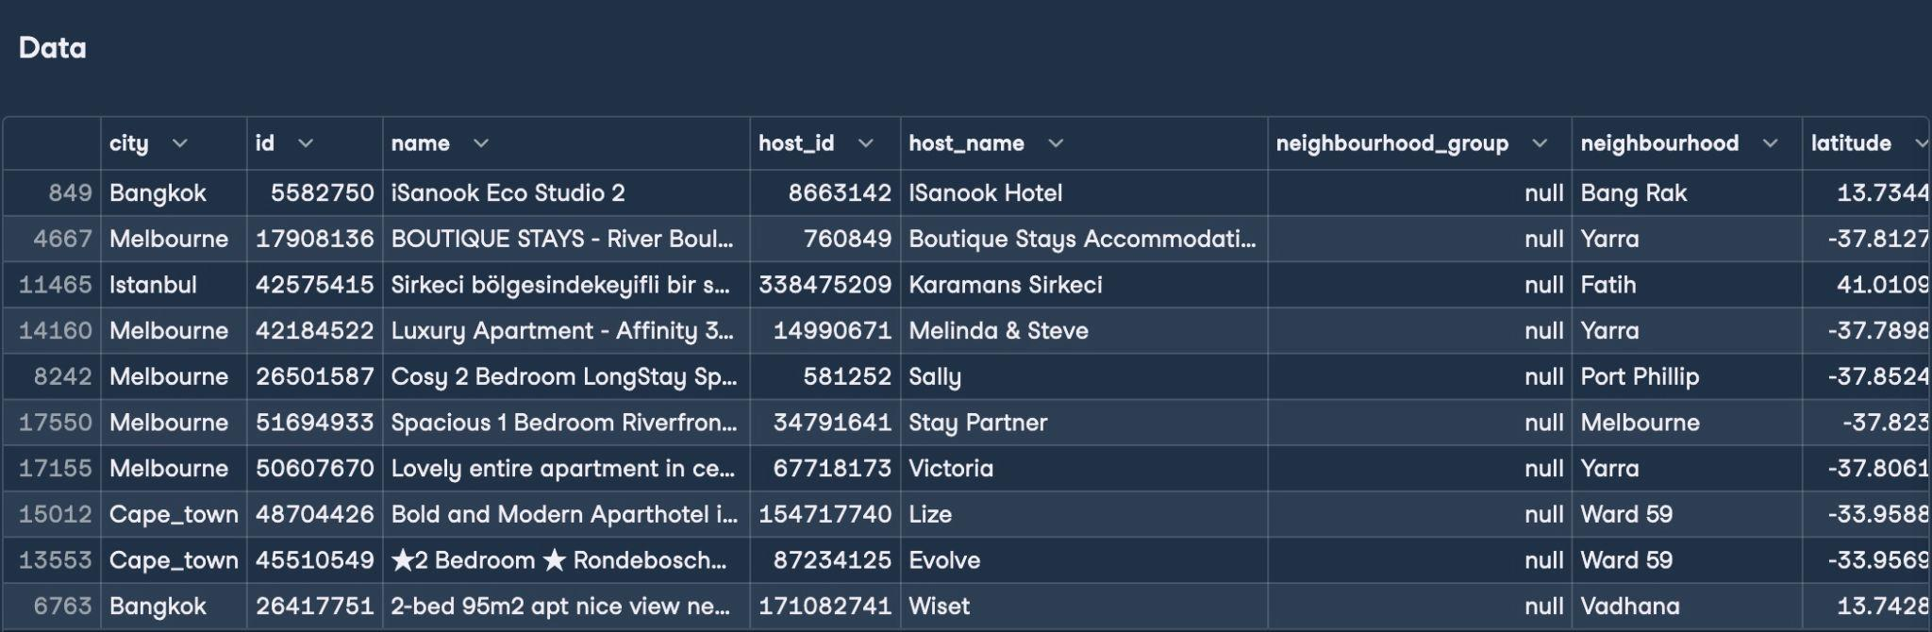
Data Collection
Source: Our data was sourced from InsideAirbnb.
Scope: Includes data from Austin, Bangkok, Buenos Aires, Cape Town, Istanbul, and Melbourne gathered
between October and November 2021.

Slide 4
Data Cleaning and Preparation
Process:
Check for duplicates: 0 duplicates found.
Rows with the most missing data:
Neighbourhood_group: 100%
License: 99.89%
Last_review: 33.6
Results upon initial evaluation:
Currency is different for the separate cities, converting all currencies to USD.
Dropping columns with the most listing values.
Converting data types
Name and host_name to string
Room_type and city to category
Last_review to datetime
Summary statistics helped find outliers.
Used Min-max and Z-score Normalization to fix the data.
Our predictors vs. Availability_365:
price_USD, Minimum_nights, number_of_reviews, reviews_per_month, calculated_host_listings_count, number_of_reviews_ltm, availability_365

Slide 5
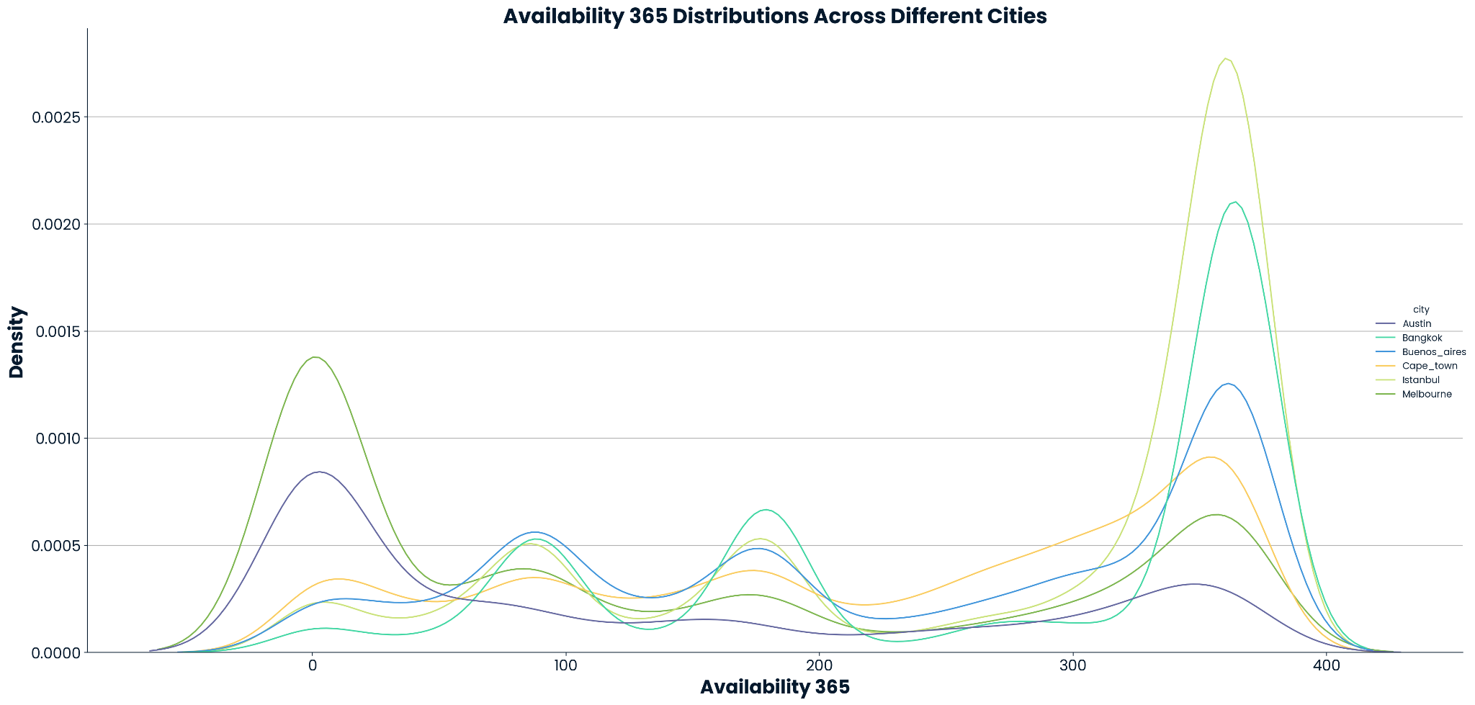
Austin and Melbourne show similar distributions (both have several properties were either always available or never available)

Slide 6
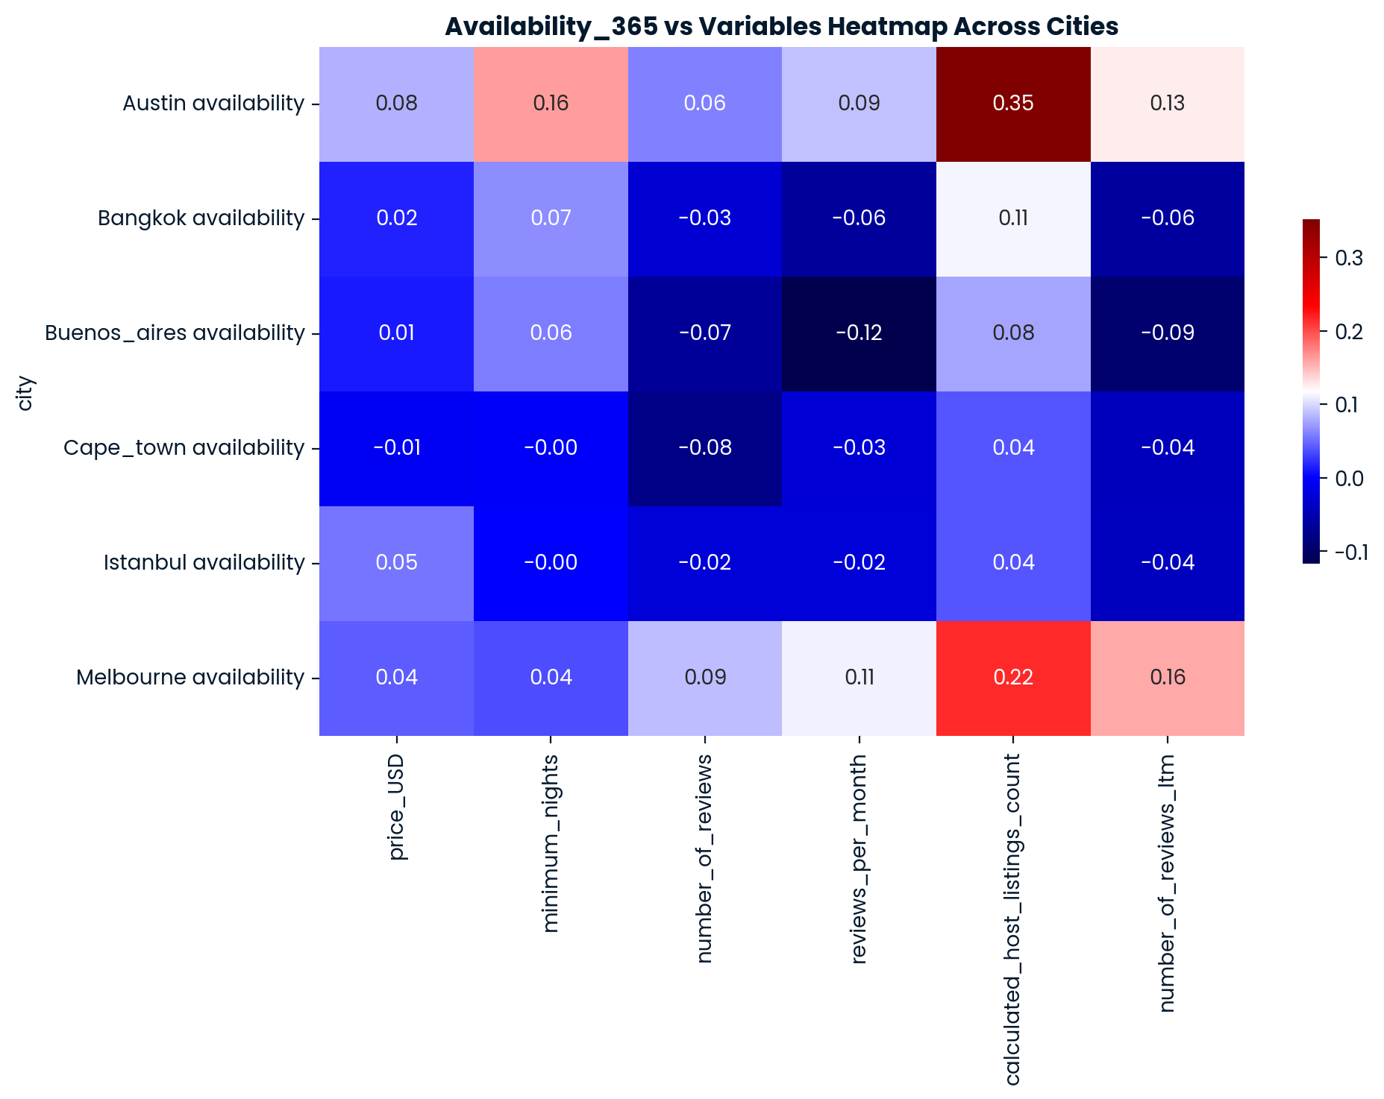
Overall, there are no strong correlations or noticeable patterns between availability_365 and all other variables for any city

Slide 7
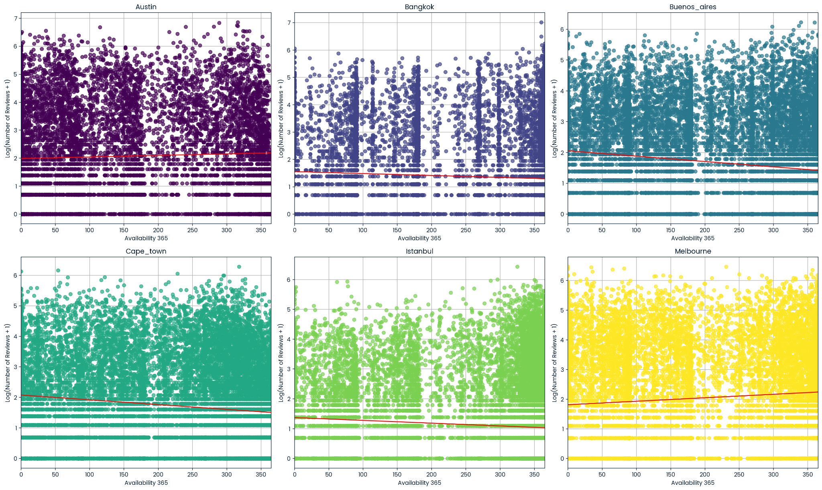
Log(Number of Reviews) vs Availability_365

Slide 8
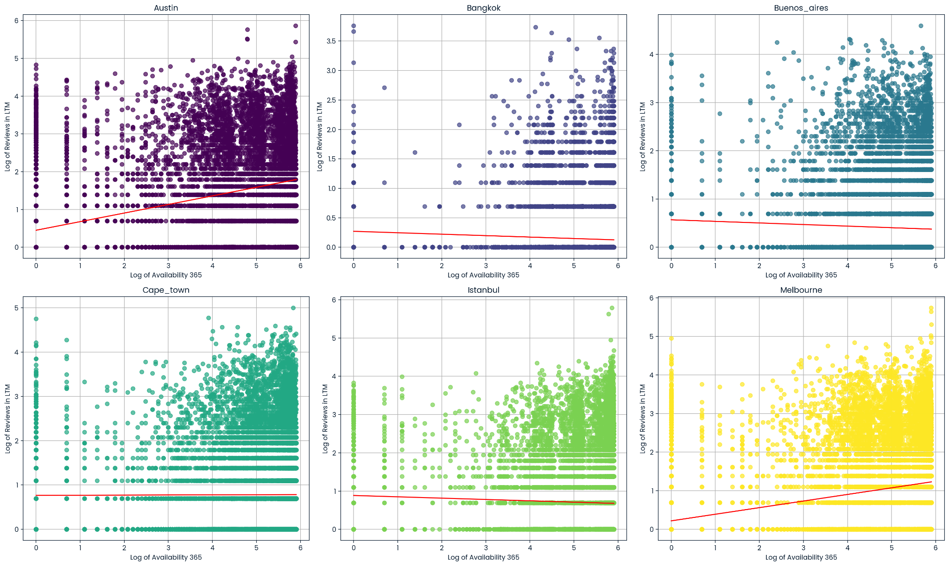
Log(Reviews in LTM) vs Availability_365

Slide 9
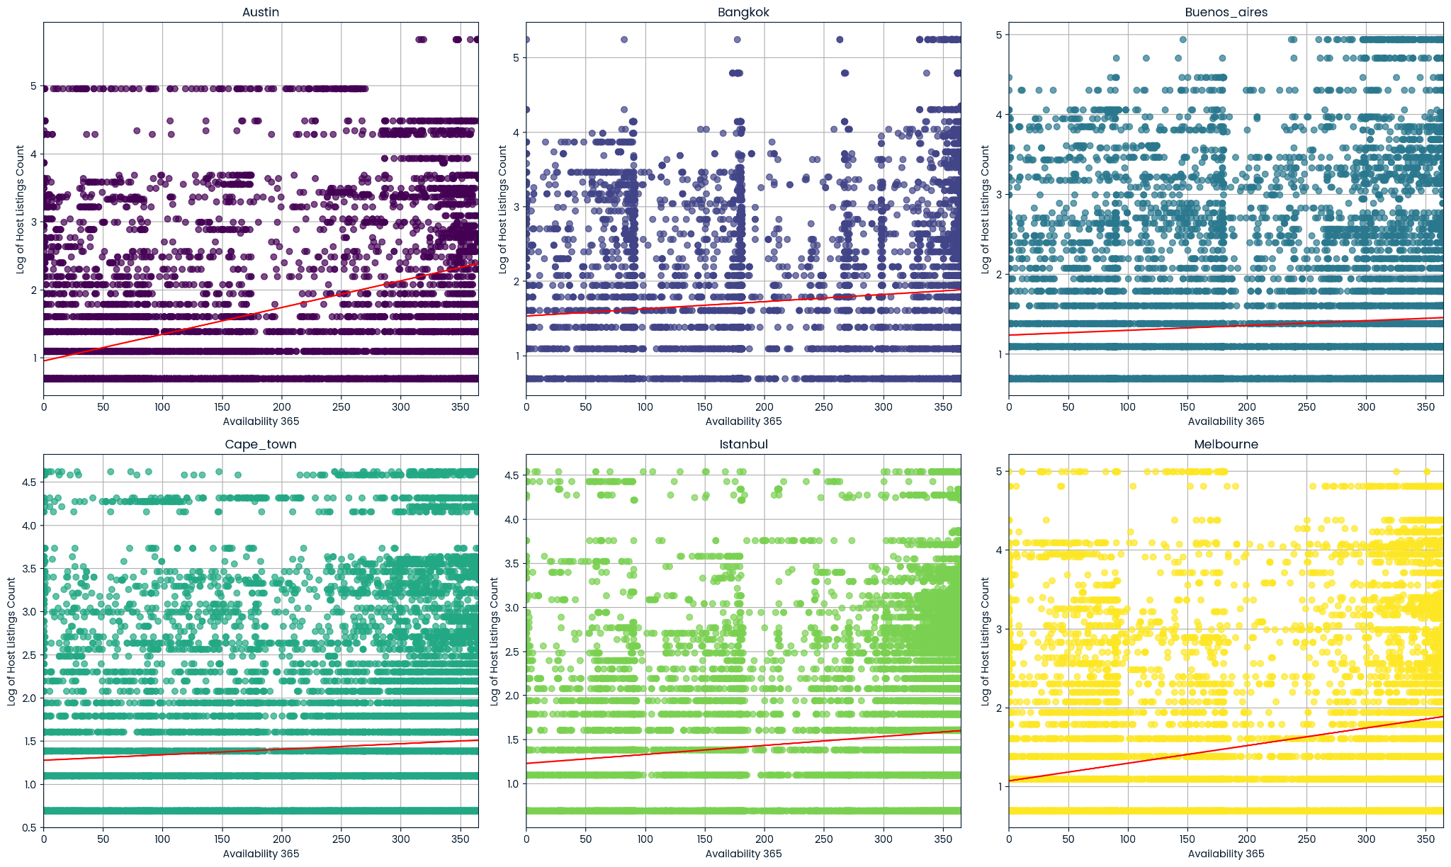
Log(Calculated Host Listings Count) vs Availability_365

Slide 10
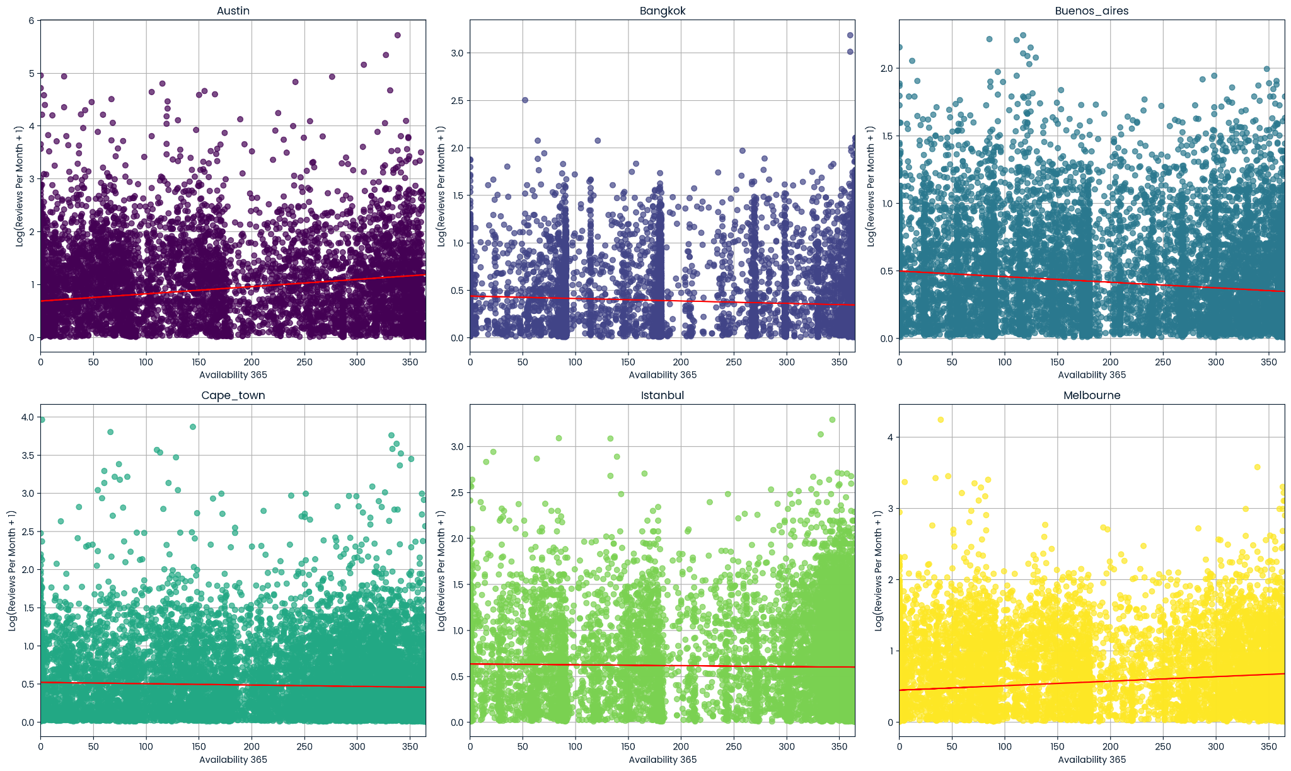
Log(Reviews Per Month) vs Availability_365

Slide 11
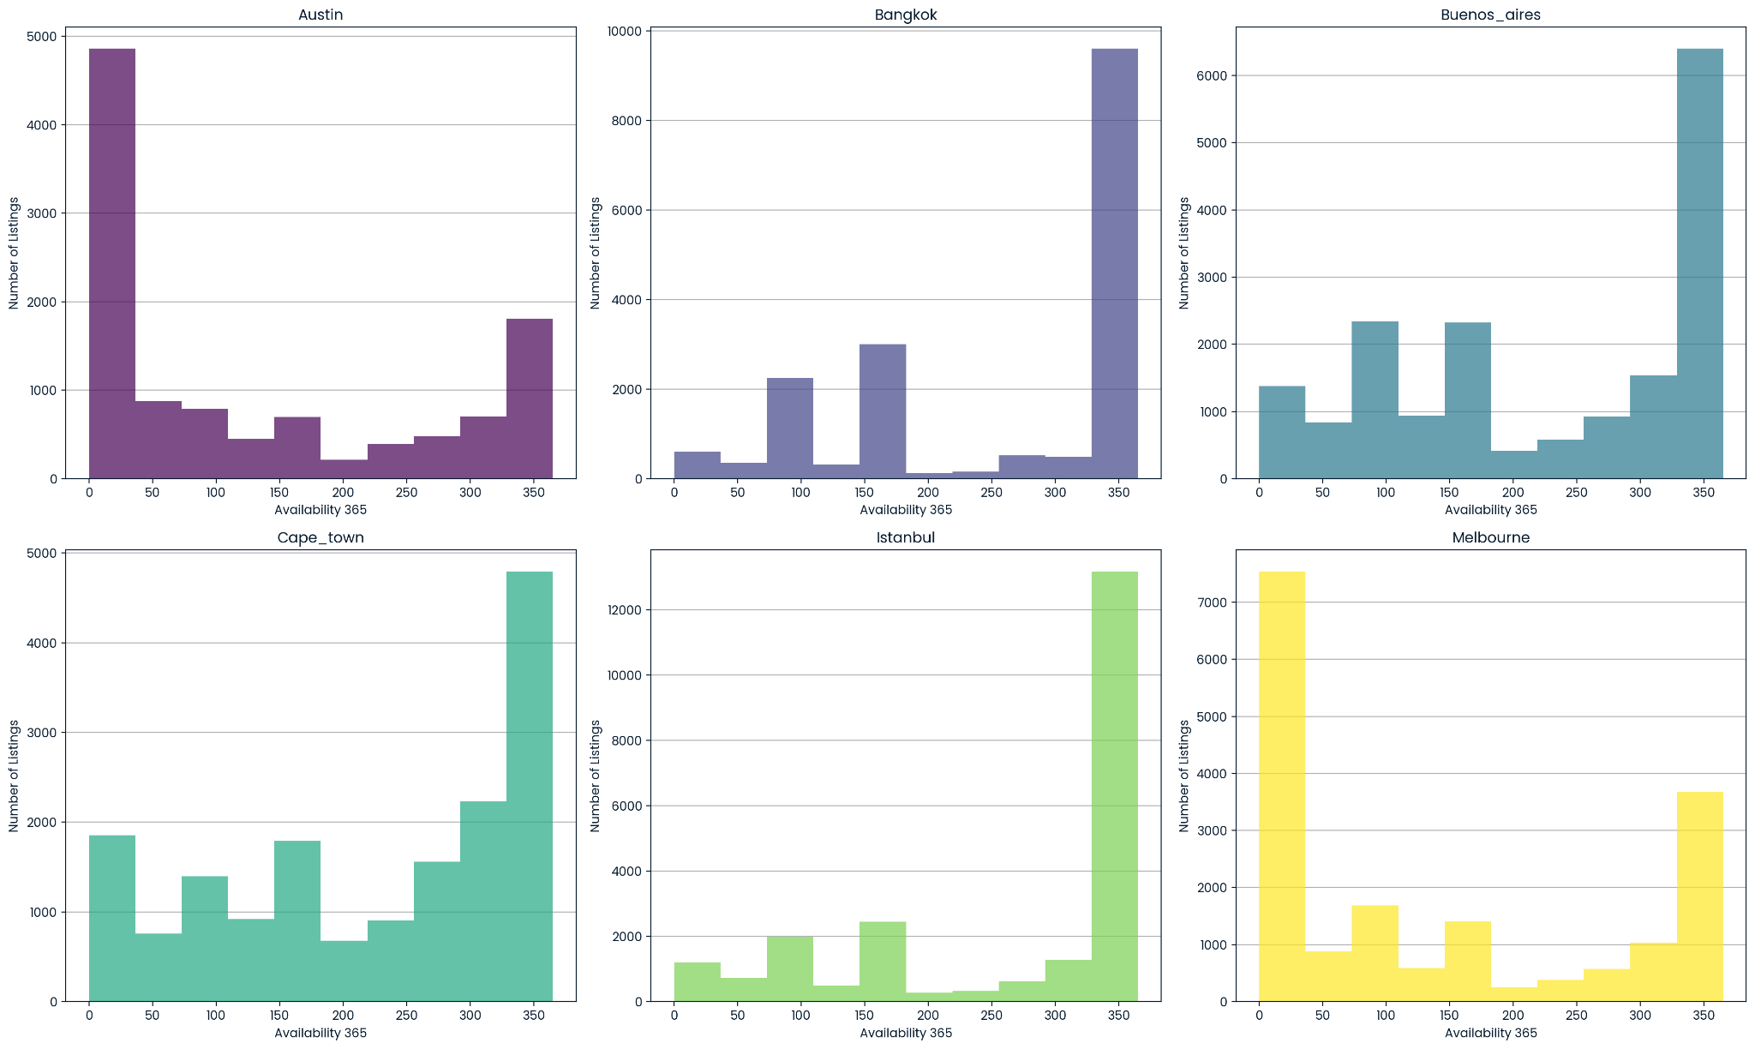

Slide 12
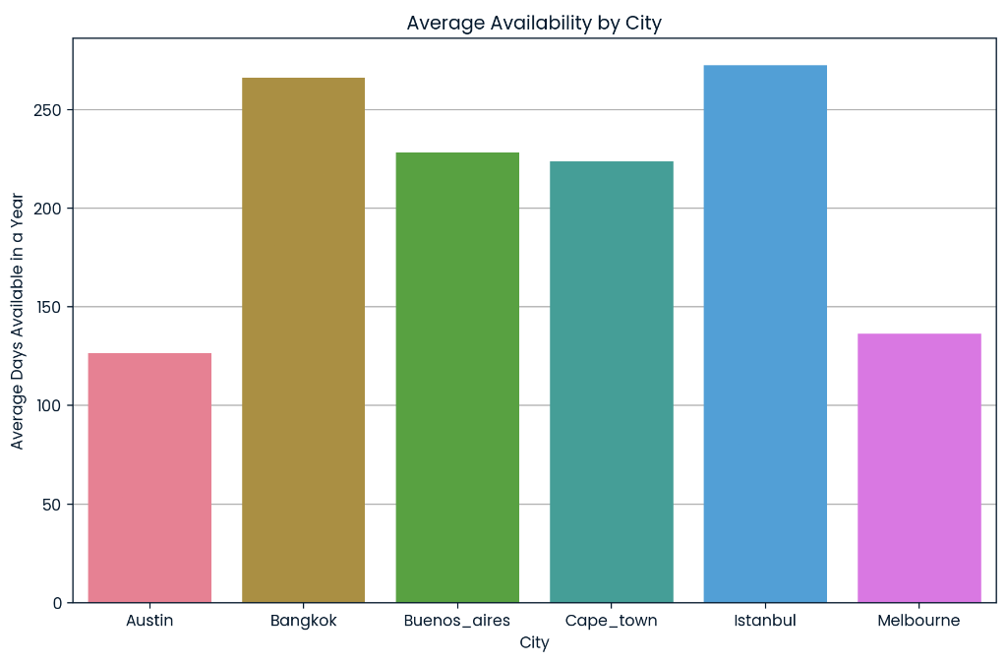
High High High High
Low Low

Slide 13
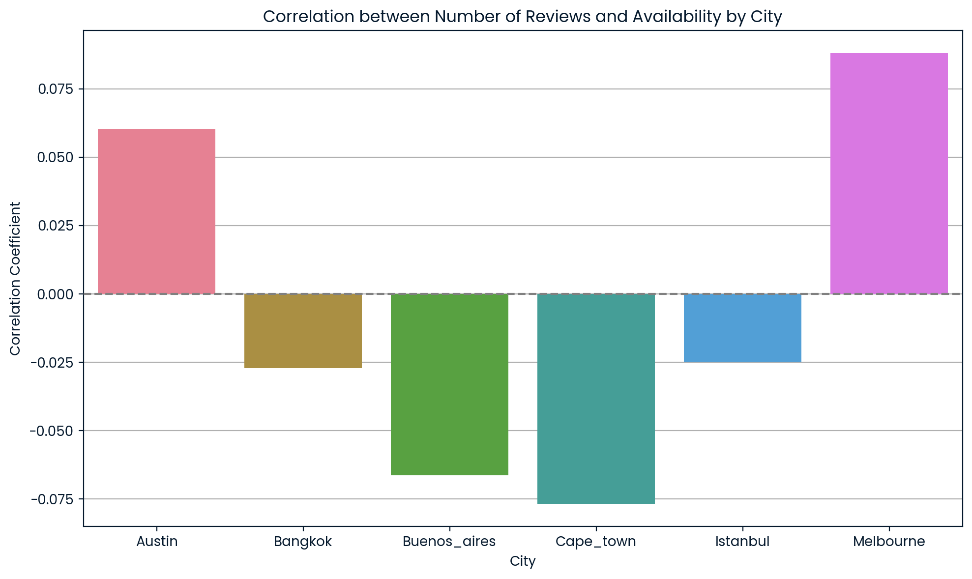
(+) (+)
(-) (-) (-) (-)

Slide 14
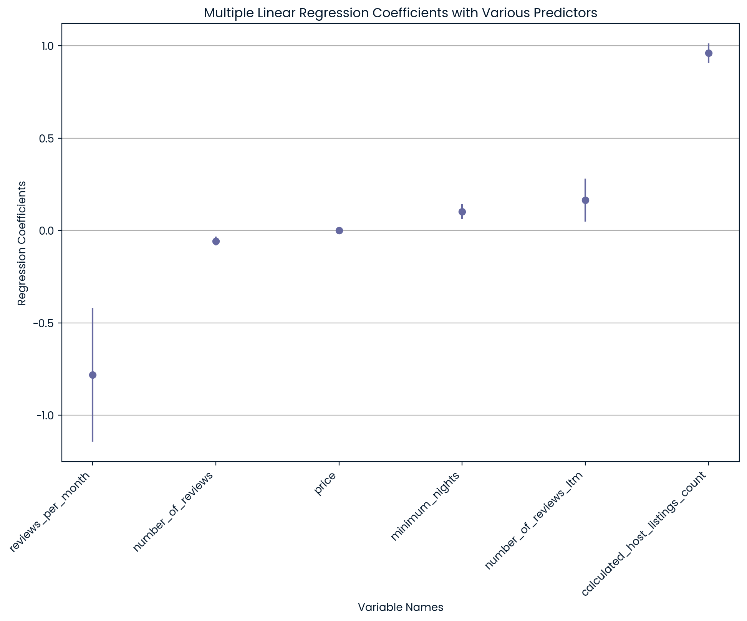
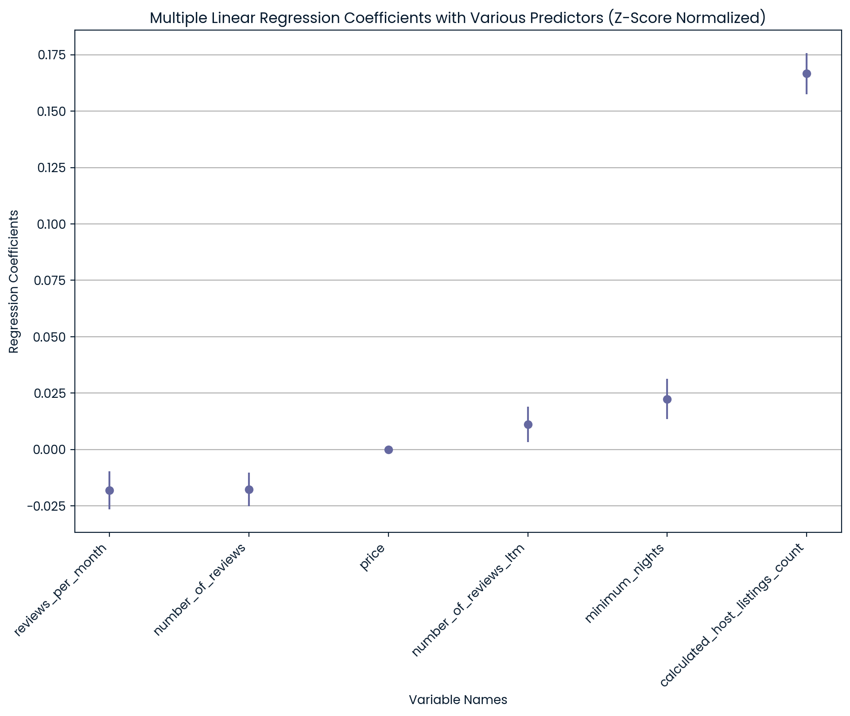
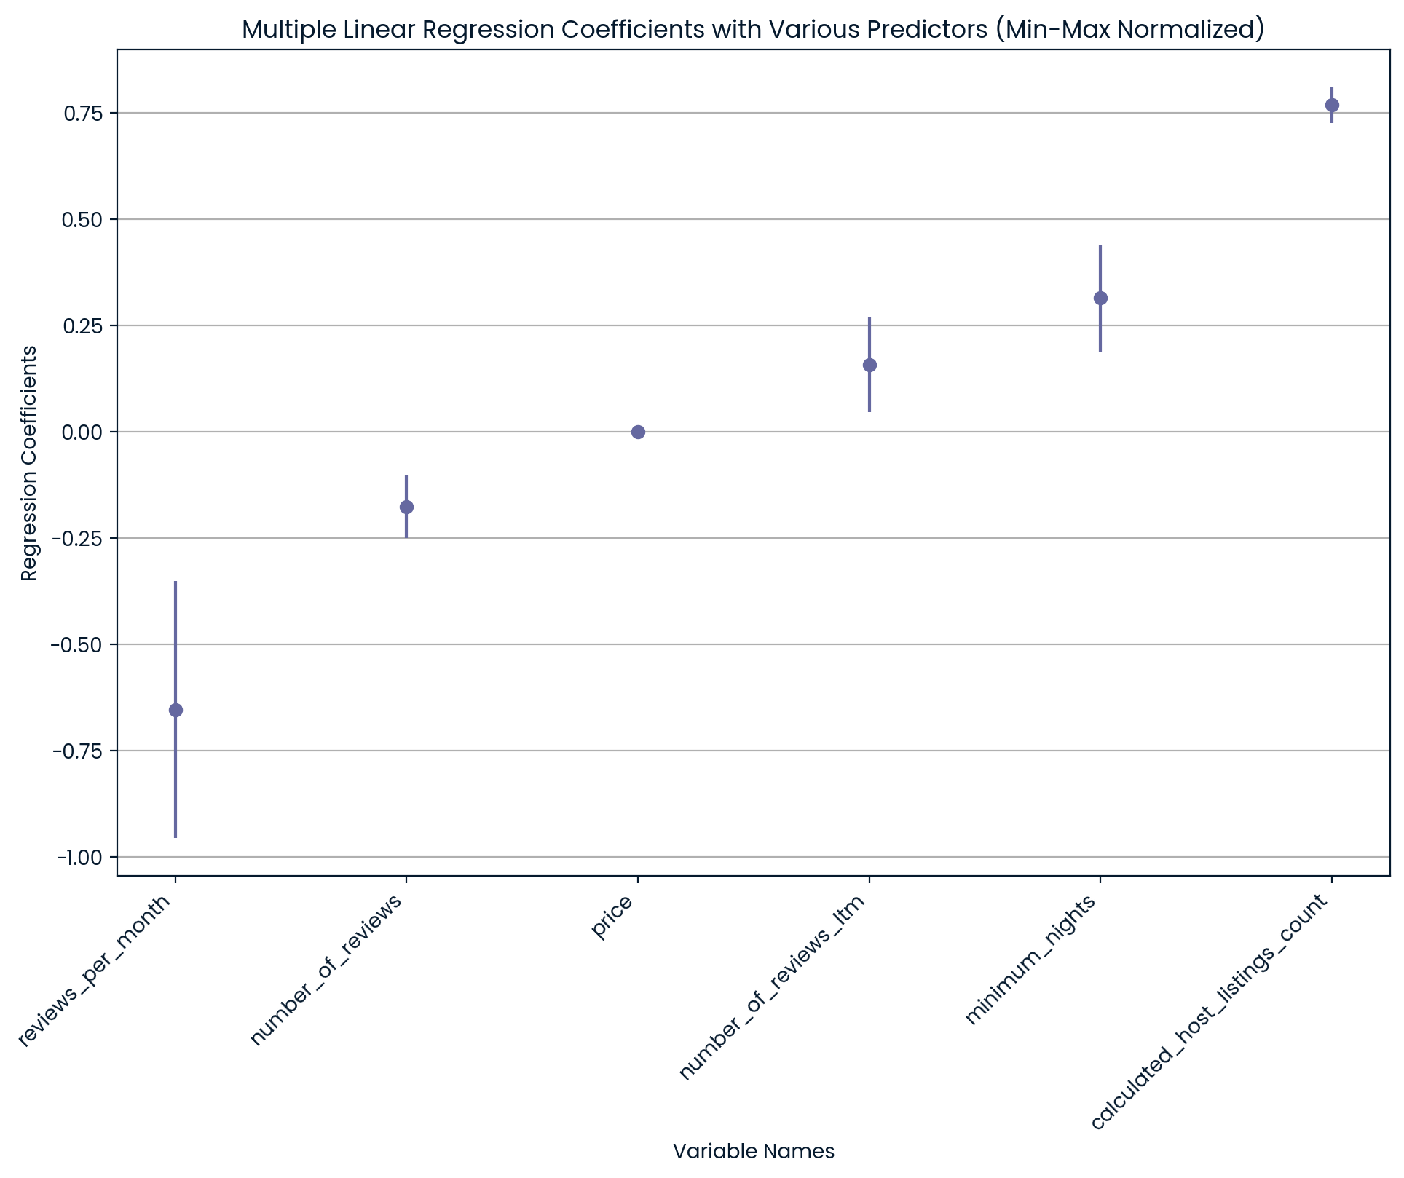

Slide 15
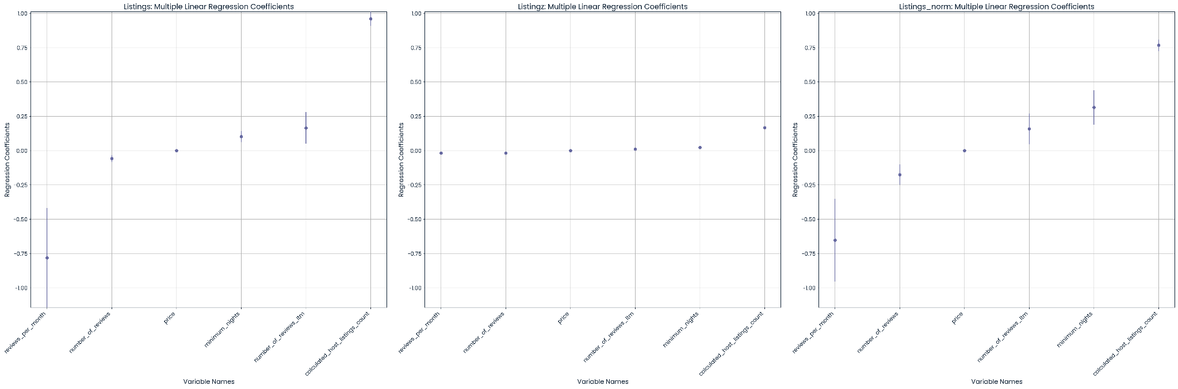
Graphic Design is my passion
Base Z-Score Min-Max

Slide 16
Predicting Availability - Linear Regression
linear Regression with best K value
Reg rmse: [139.93535156 125.2489999 149.18201384]
Reg mean: 138.12212176943902
Ridge Output
Reg rmse: [146.68849982 127.15933769 121.98980838 139.29340689 163.25423015]
Reg mean: 139.67705658652923
Lasso Output
Reg rmse: [148.00193943 129.71173524 120.87153431 139.32014808 164.67291095]
Reg mean: 140.5156536030636
Best alpha Lasso: {'alpha': 0.11}
Best score: 140.37267933325717
Best alpha for Ridge: {'alpha': 35.91}
Best score: 140.42247651377042

Slide 17
Predicting Availability - K Nearest Neighbor
K=4
Reg rmse: [152.63273954 143.14140478 148.92419814 144.78252096 164.92830522]
Reg mean: 150.88183372812847
K=7
Reg rmse: [146.11791276 137.01954637 143.27724331 139.09175419 160.09648085]
Reg mean: 145.12058749824047
K=10
Reg rmse: [142.9409789 133.66182698 140.54830647 136.85356219 158.05352752]
Reg mean: 142.41164041386685
Best n_neighbors: {'n_neighbors': 20}
Best score: 139.8292398467426

Slide 18
Predicting Availability - Decision Tree
Decision Tree Output:
Reg rmse: [186.21017266 176.14512149 183.19027061 178.67933022 200.05885253]
Reg mean: 184.85674950276993
Random Forest Output:
Reg rmse: [142.01910927 130.51645811 137.10995249 131.76105293 158.80058943]
Reg mean: 140.0414324450686
Best tuned params: {'min_samples_split': 3, 'min_samples_leaf': 1, 'max_features': 'log2', 'max_depth': 10}
Best score: 134.93641959174474
Decision Tree Tuned Parameters Output:
Reg rmse: [141.96385831 131.06314412 137.43243927 132.22995406 158.35377911]
Reg mean: 140.20863497423892

Slide 19
Let's take a different approach and make availability a binary value. To define this value we will define available = 0 when availability_365 = 0 and available = 1 when availability_365 != 0 then fit that to a logistic regression model. Doing this we achieve an average accuracy across all cities of 90.23%
City: Austin
Scores: [0.76274165 0.88927944 0.86760398 0.89976553 0.66764361]
Mean score: 0.8174068434849675
City: Bangkok
Scores: [0.97433414 0.97384988 0.9748062 0.9748062 0.9748062 ]
Mean score: 0.9745205248043245
City: Buenos_aires
Scores: [0.96155436 0.96155436 0.96195203 0.96195203 0.96195203]
Mean score: 0.9617929604034232
City: Cape_town
Scores: [0.95173267 0.95212546 0.95212546 0.95212546 0.95171275]
Mean score: 0.9519643637908981
City: Istanbul
Scores: [0.96810273 0.96810273 0.96810273 0.96768848 0.96768848]
Mean score: 0.9679370339685169
City: Melbourne
Scores: [0.64246824 0.76261343 0.75136116 0.73238925 0.81989833]
Mean score: 0.7417460825830634

Slide 20
Weighted Coefficients
logreg_features
logreg_coeff
4
number_of_reviews_ltm
14.4564113054
3
calculated_host_listings_count
9.5479104214
0
minimum_nights
2.8491788773
2
reviews_per_month
1.9507423915
1
number_of_reviews
0.0932323179
5
price_USD
-5.2132236453

Slide 21
Reduced Logistic Regression Model
Number_of_reviews_ltm, calculated_host_listings_count, minimum_nights, and reviews_per_month all have positive coefficients, so these will be used as the predictors for our reduced model. After dropping the number of reviews and the price in USD we now have an improved accuracy of 90.66%
City: Austin
Scores: [0.83362624 0.88049209 0.85061511 0.89390387 0.65650645]
Mean score: 0.8230287534055687
City: Bangkok
Scores: [0.97433414 0.97384988 0.97432171 0.9748062 0.9748062 ]
Mean score: 0.9744236255795183
City: Buenos_aires
Scores: [0.96155436 0.96155436 0.96195203 0.96195203 0.96195203]
Mean score: 0.9617929604034232
City: Cape_town
Scores: [0.95173267 0.95212546 0.95212546 0.95212546 0.95171275]
Mean score: 0.9519643637908981
City: Istanbul
Scores: [0.96810273 0.96810273 0.96810273 0.96768848 0.96768848]
Mean score: 0.9679370339685169
City: Melbourne
Scores: [0.71506352 0.75789474 0.76188748 0.73638344 0.83260712]
Mean score: 0.7607672588427722

Slide 22
Multidimensional Analysis - Combining Dimensions
Interaction Host Listings Min Nights: calculated_host_listings_count * minimum_nights
The result is a measure of the combined commitment required from a guest across all listings managed by a host.
Reviews Per Listing: number_of_reviews / calculated_host_listings_count
Calculates the average number of reviews per listing managed by a host.
Monthly Reviews Per Night Required: reviews_per_month / minimum_nights
Help understand the booking and review frequency relative to the booking constraints.
Activity Index: (reviews_per_month / 2) + (number_of_reviews_ltm / 2)
Measure of recent activity or popularity of a listing, combining recent reviews with a monthly review count.
Performance Score: Average of (number_of_reviews, reviews_per_month, & number_of_reviews_ltm)
gauge the overall performance or popularity of a listing based on its review activity over time and recently.

Slide 23
Predicting Availability - Gradient Boosting
Predicting Availability - Multidimensional Linear Regression
Gradient Boosting Regressor Output:
Reg rmse: [136.27452726 126.31800389 133.12715169 127.87620607 151.77010114]
Reg mean: 135.0731980094318
Linear Regression with Combined Dimensions Output:
Reg rmse: [136.23452153,132.82740986,140.45781427,130.09678234,146.08862422]
Reg mean: 137.12817247761558

Slide 24
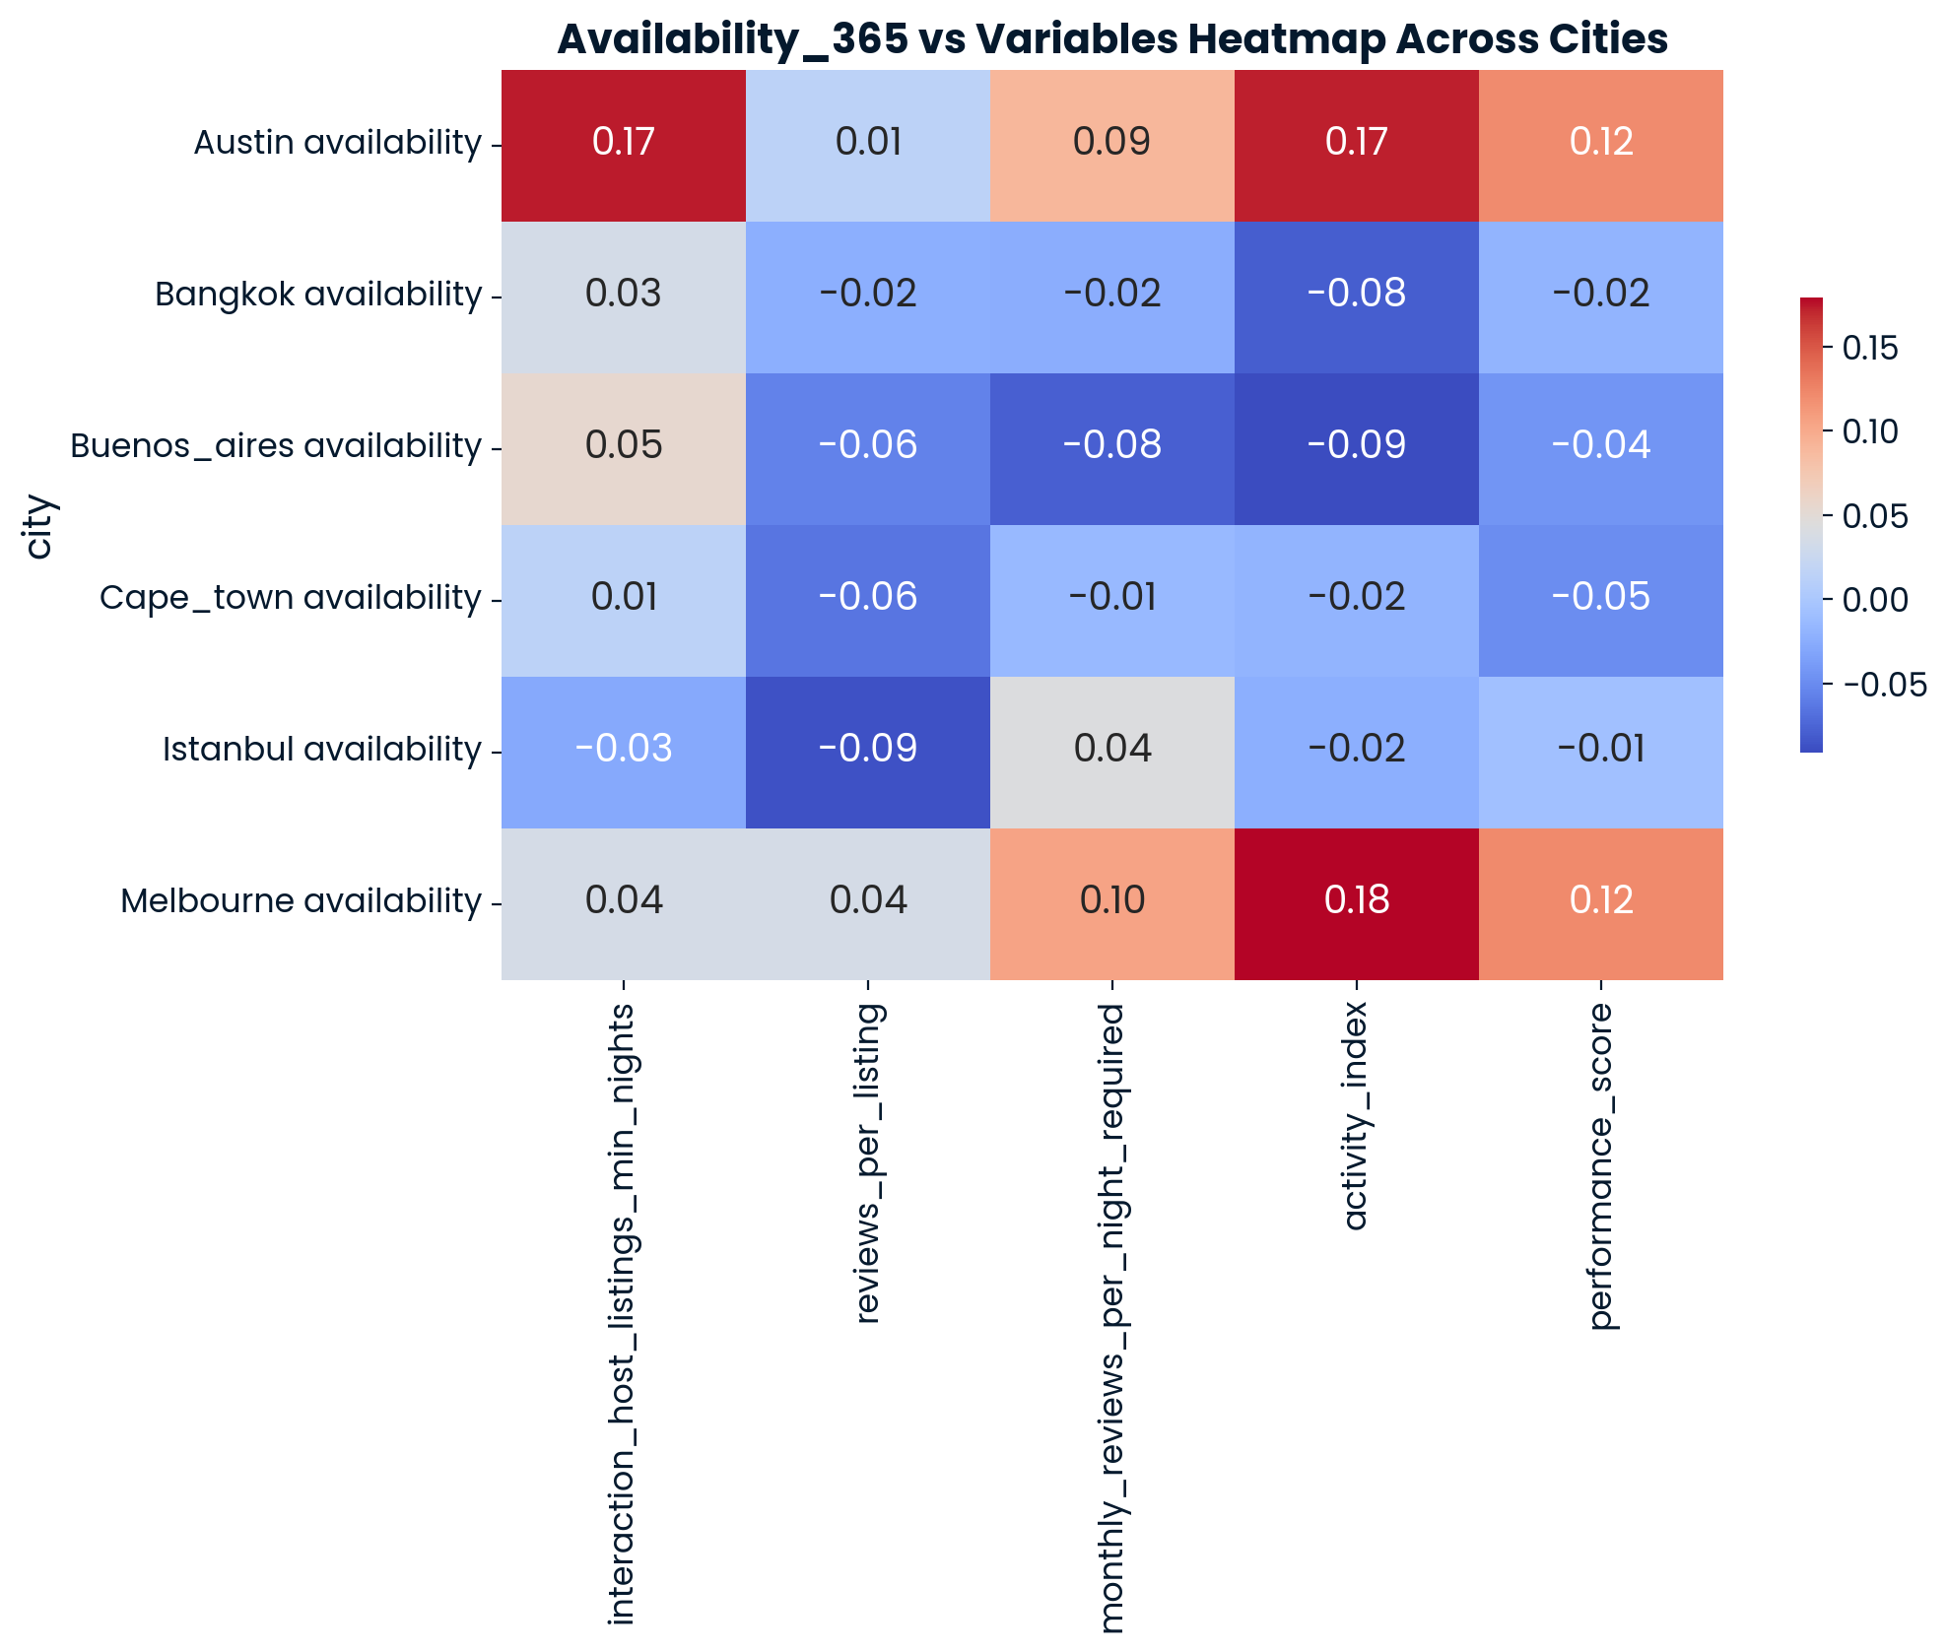

Slide 25
Interpretation and Reporting
Calculacted host Listing count and number of reviews ltm had the highest correlation with availability_365
The highest accuracy we achieved in predicting availability_365 was 90% using the logistic regression model
The predictors with the strongest effects on the predicting availability was calculated_host_listings_count and reviews_per_month
Austin and Melbourne followed similar trends and patterns
Bangkok, Istanbul, Buenos Aires, and Cape Town followed similar trends

Slide 26
Questions? (examples provided below)
How much did you suffer to make this?
How little sleep did you get last night?
Is graphic design your passion?
Can you take my final for me?
What are your names again?
What is your favorite color?
¿Qué Tiempo Hace hoy?
Two trains are on the same track, 100 km apart, heading towards each other. Train A is traveling at 50 km/h, and Train B is traveling at 50 km/h as well. A fly starts at the front of Train A and flies towards Train B at 75 km/h. When the fly reaches Train B, it turns around and flies back to Train A. How many kilometers does the fly travel before getting squashed in the collision of the two trains?

